Slide 1
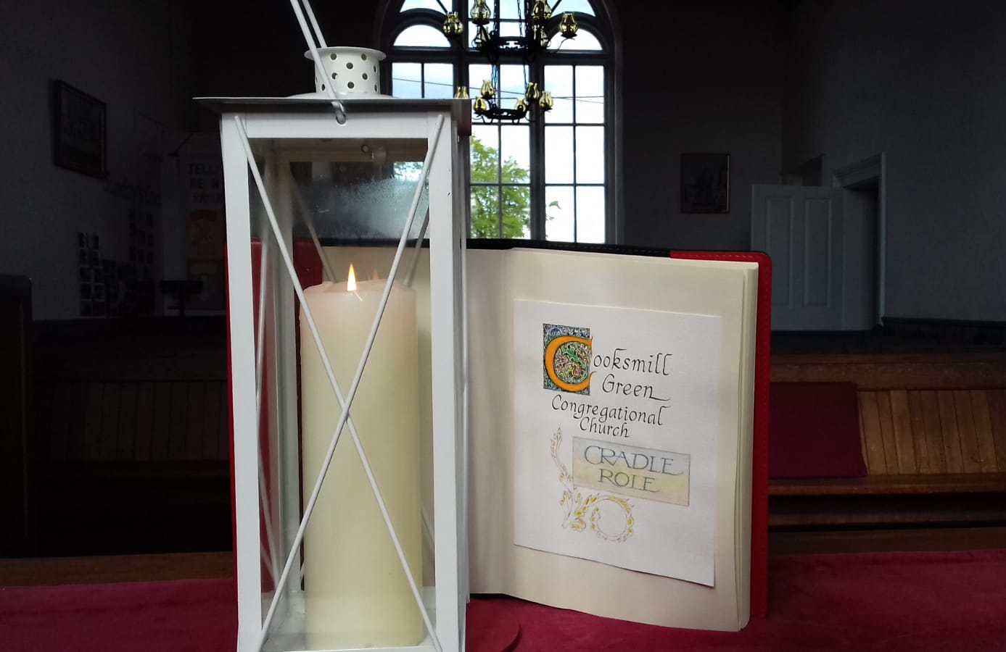
3rd May 2020

Slide 2
Time to hear from some of our
Sunday’s Cool Club
(with some light relief)
What have you been doing
during lockdown?

Slide 3
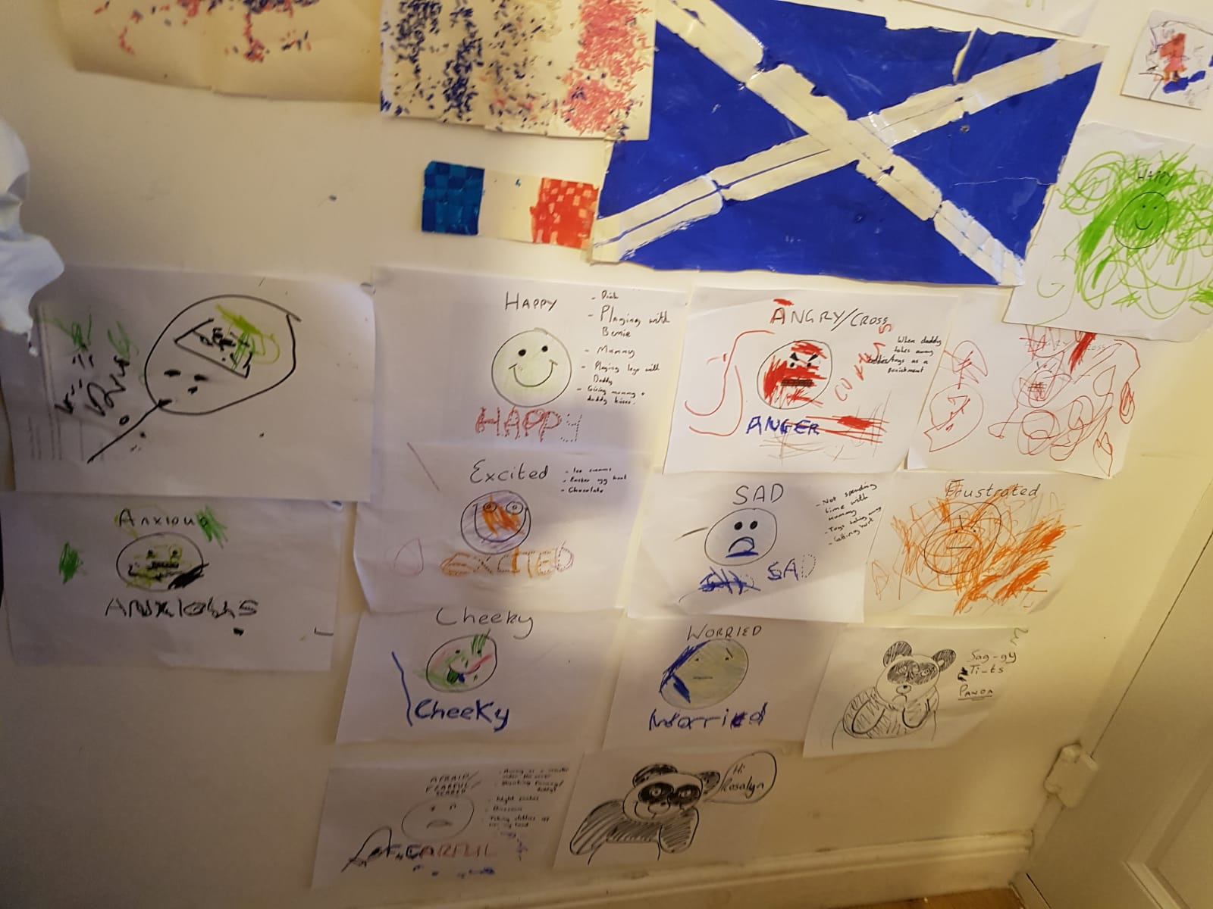
Going into competition with the emoji designers..
(Rosalyn & Bernie)

Slide 4
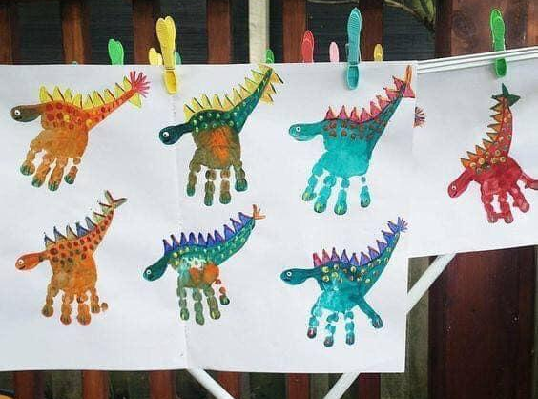
Great hand Dinosaurs by Frances & Luke

Slide 5
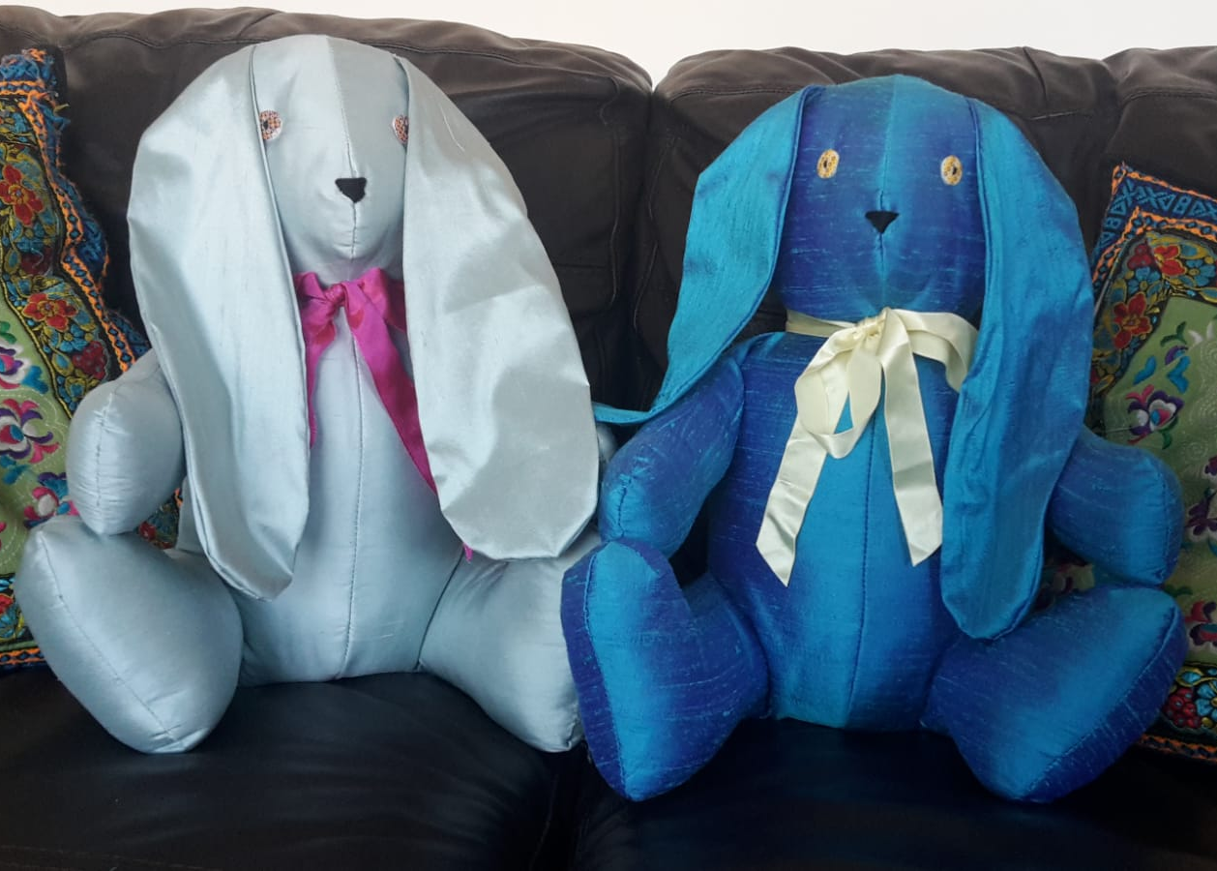
Who can resist a Lockdown Bunny?
(Isla & Rosie)

Slide 6
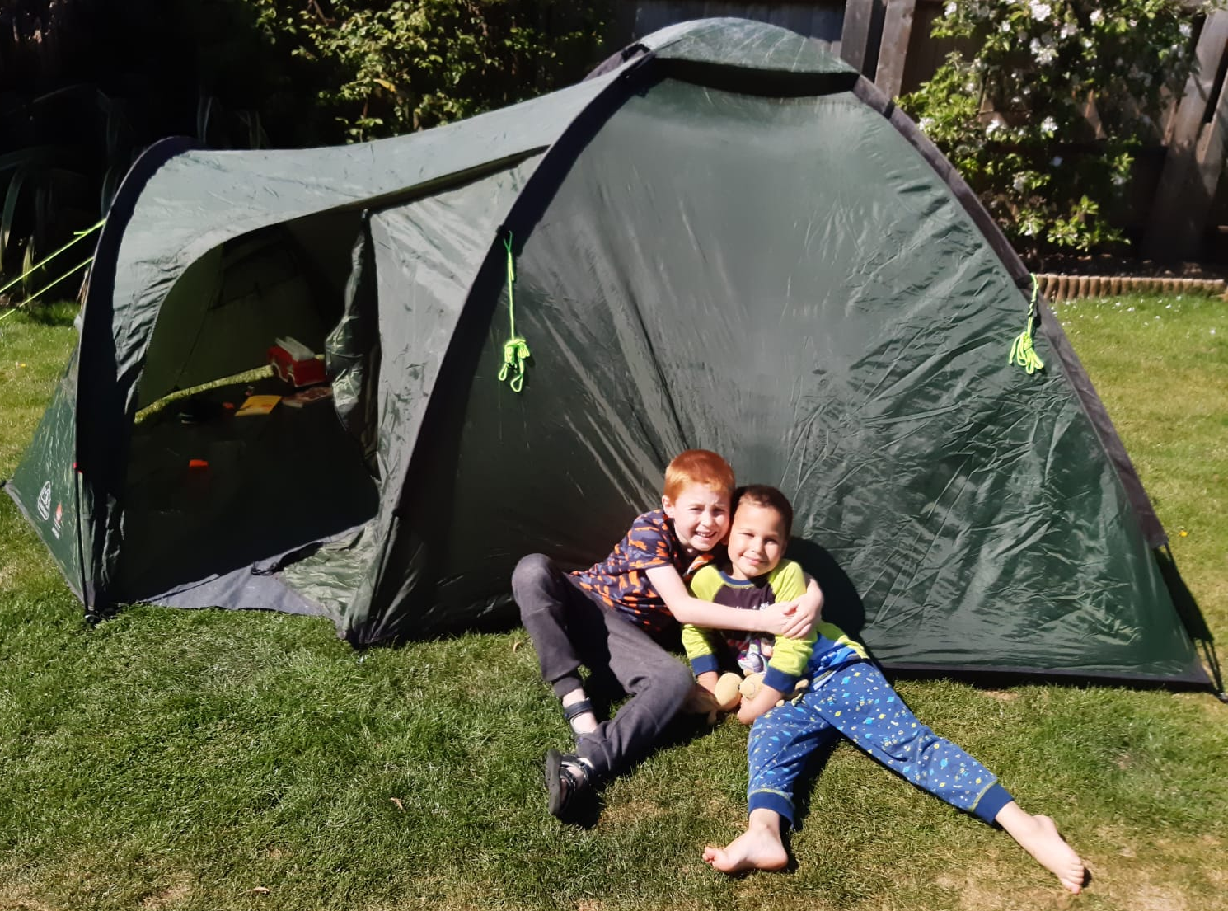
Having a brother to camp with just beats everything!

Slide 7
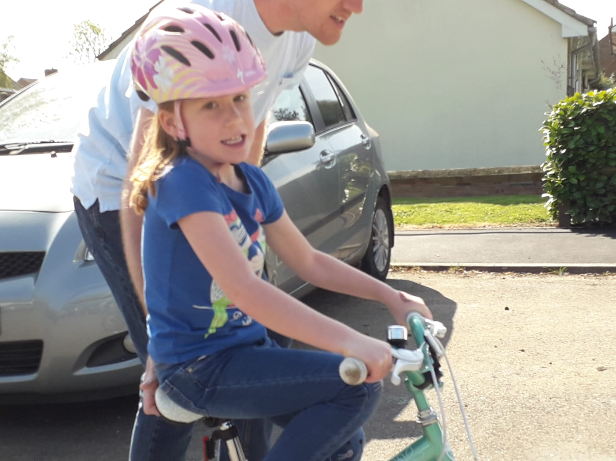
Sometimes we need Daddy to help… until we can do it on our own… I can now!

Slide 8
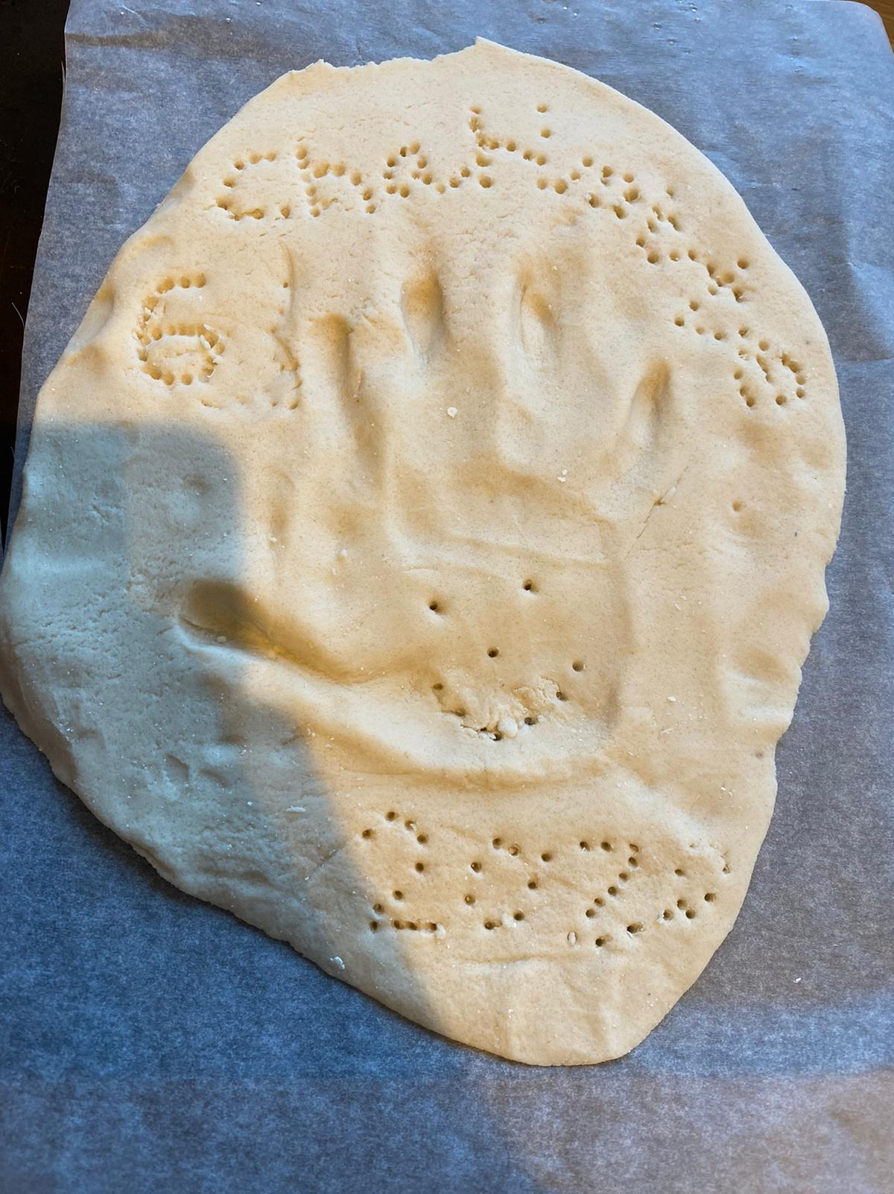
Salt Dough modelling by Charlotte

Slide 9
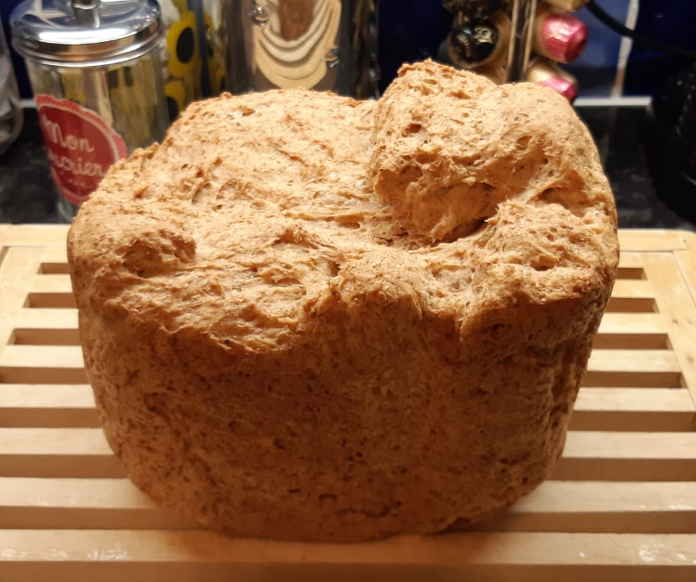
Busy making the staff of life (Ellen)

Slide 10
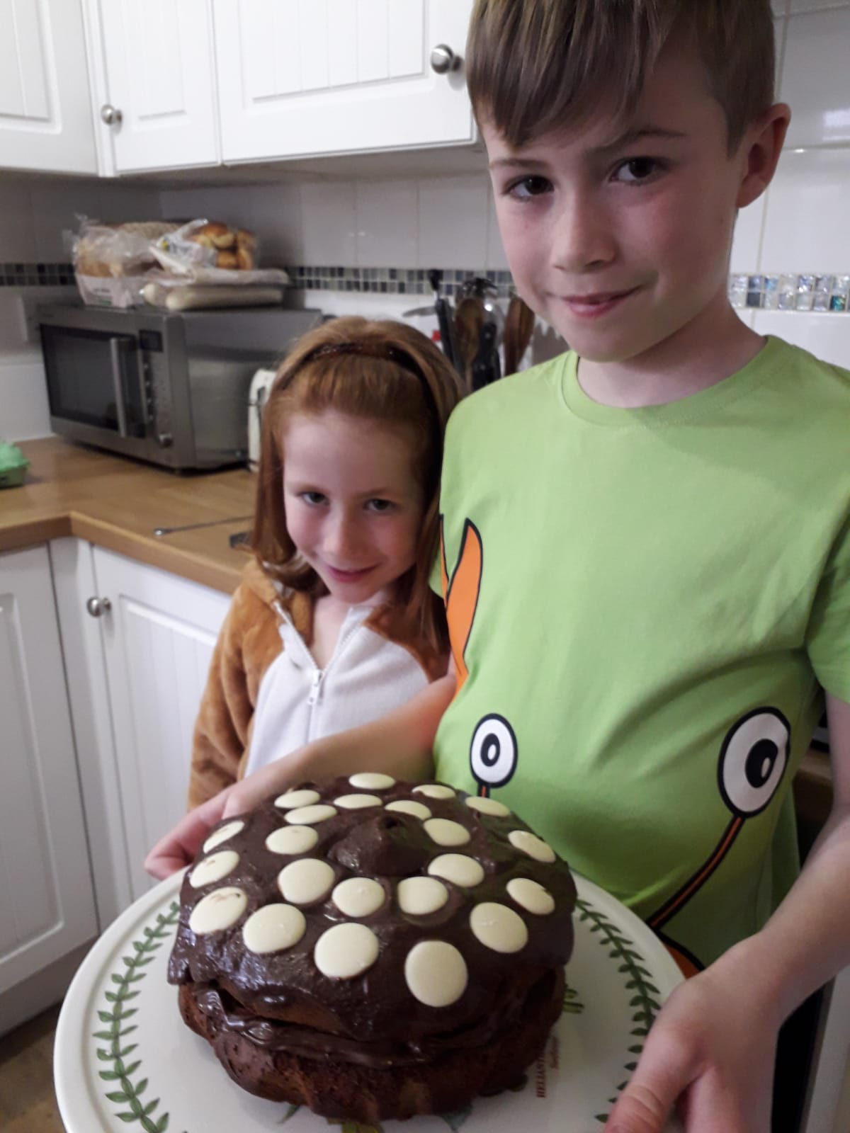
Eat your heart out Jamie Oliver

Slide 11
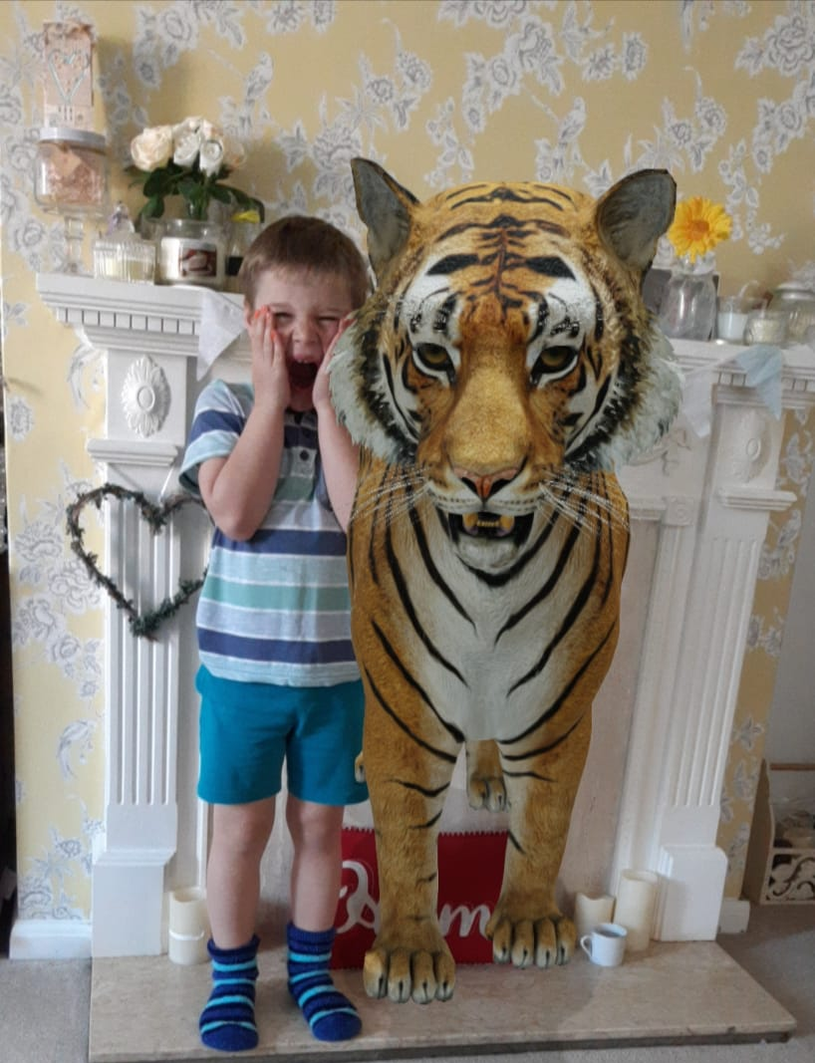
I thought it was only Santa Claus who came down the chimney!
I was told he wanted to commune with nature

Slide 12
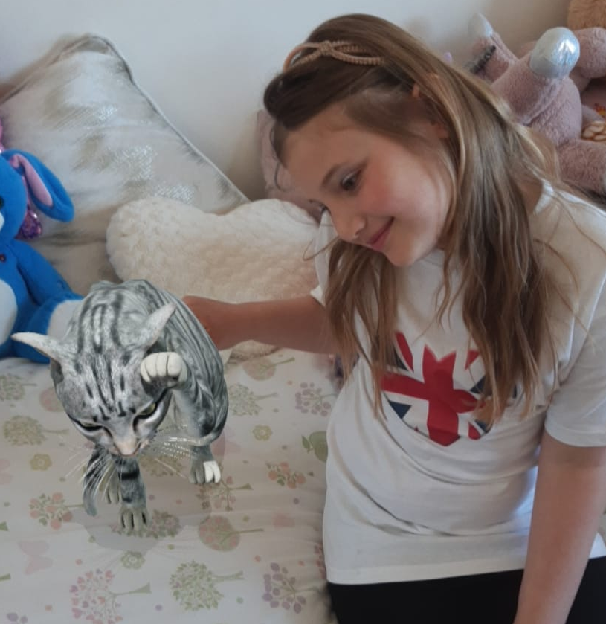
There are less scary ways to enjoy wild life.

Slide 13
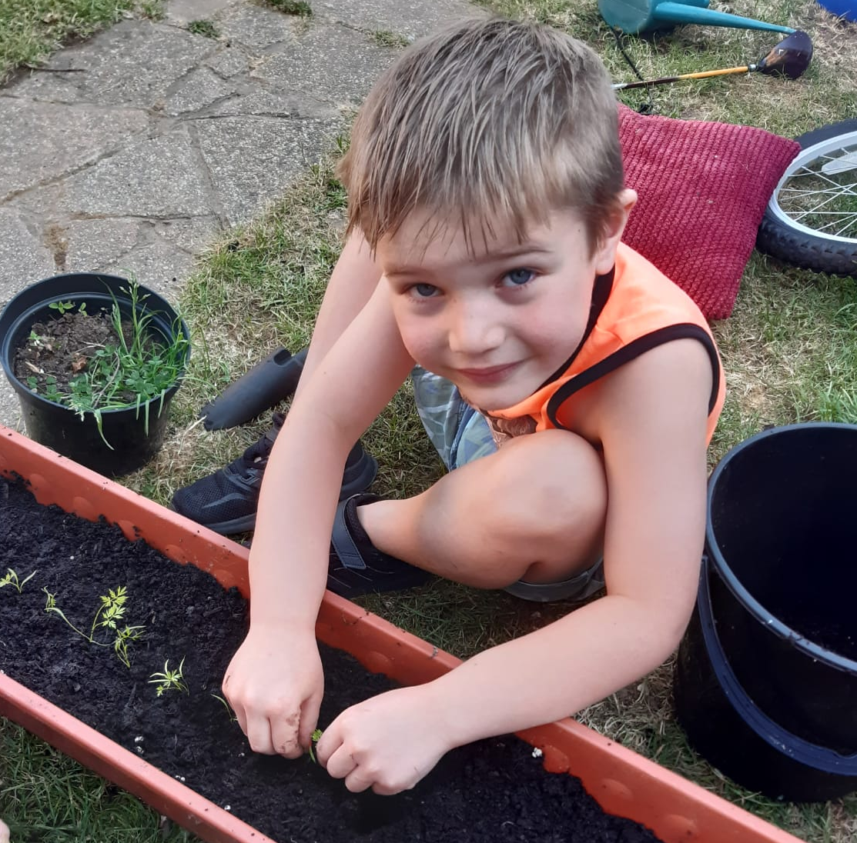
I Know God can do it, but sometimes it’s nice to help out

Slide 14
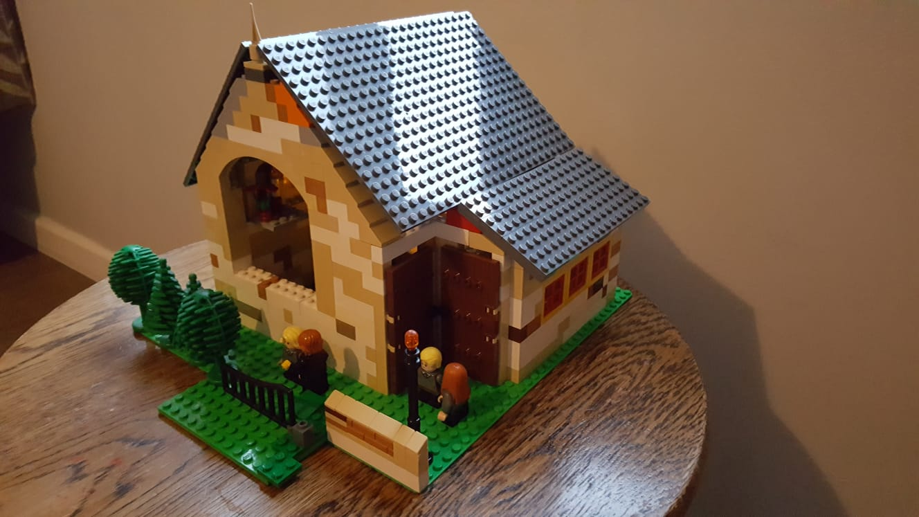
Sunday morning at Cooksmill Green
- well Nearly
(The Randells)

Slide 15
What do you think of the Lockdown?
When it’s sunny I get to go outside and I don’t do much work (Fred) …..Mummy’s a teacher!
Badish sometimes because I can’t see family and friends. (Fred)
What are you looking forward to afterwards?
Hugging my family (Bethany)
I’m not looking forward to going to school! (Rosie)
Going to Thorp Park
(Harry & Edward)
Going to school (Bethany)
Seeing my friends
(Isla)

Slide 16
Anything else
you’d like to say?

Slide 17
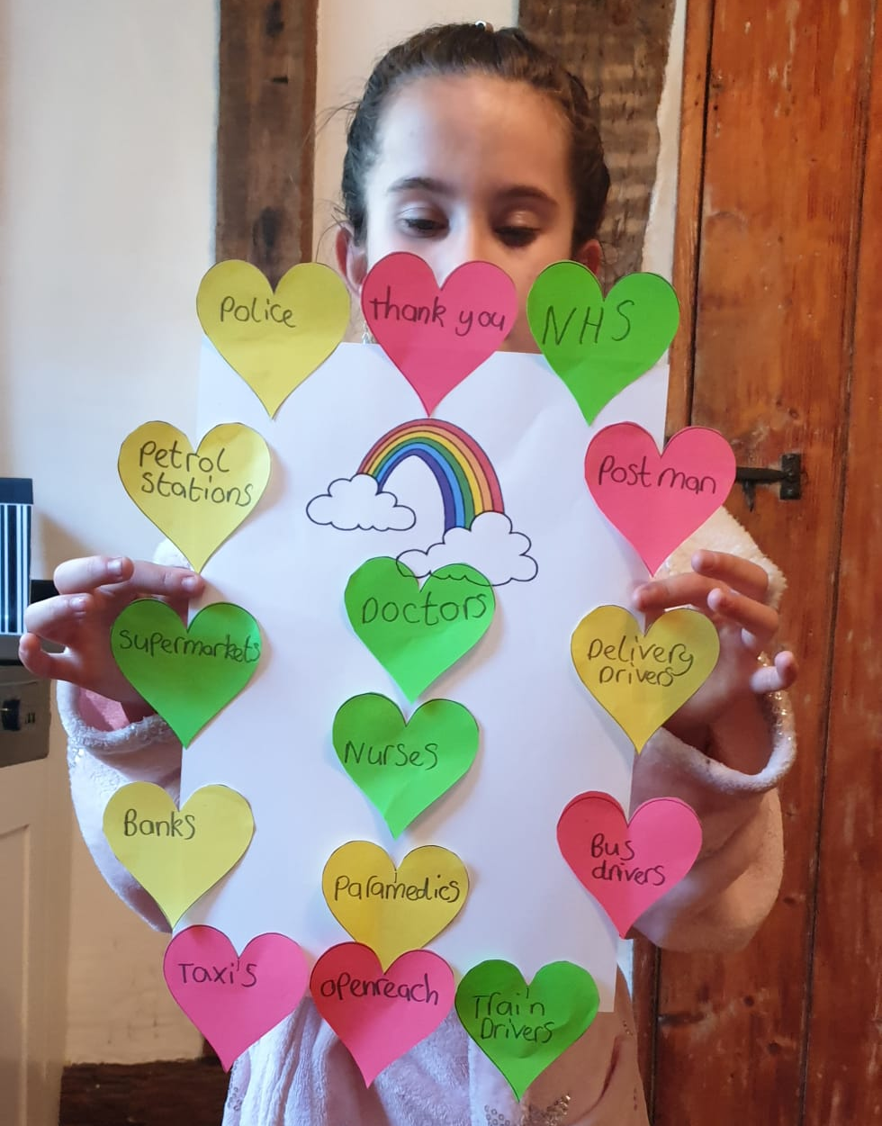
Lots of Great Big
THANK YOUs
Thank you!
Thank you!
Thank you!
Thank You!
Thank you!
Thank you

Slide 18
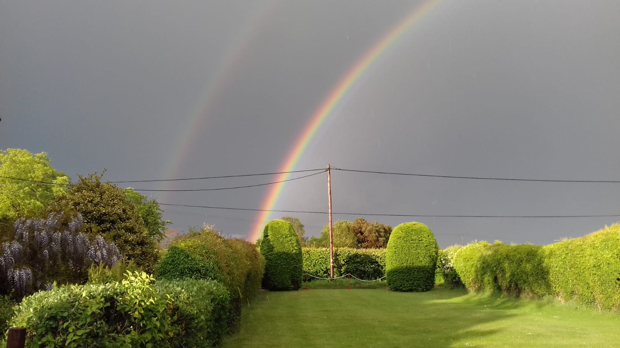
Thank you
Father

